Slide 1
JavaScript Performance Tuning Secrets
Peter Flynn | Adobe
Slides & links: github.com/peterflynn/jsconf-2013
Notes:
See GitHub link for more notes & further reading.

Slide 2

Me
Brackets
Notes:
The Brackets UI is >100k lines of JS code (>10MB) (including 3rd-party libraries)

Slide 3

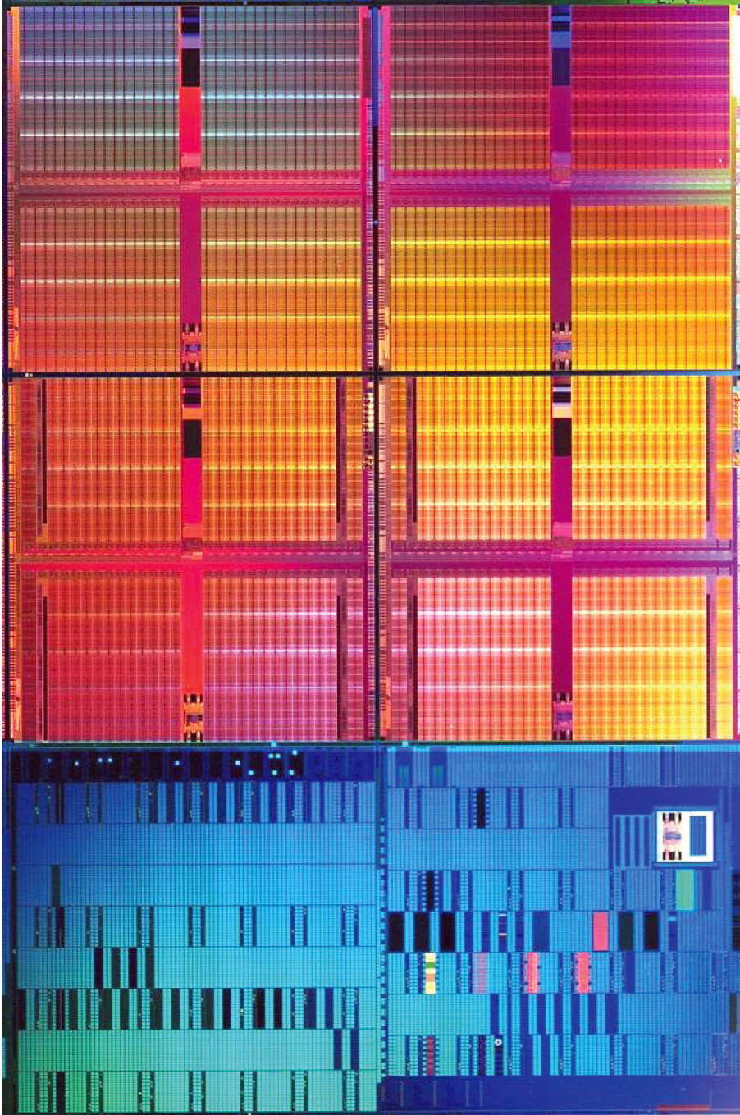
Why is This Hard?
?
?
?
var start = performance.now();
// ... Do some stuff ...
var end = performance.now();
console.log((end – start) + "ms");
// CSS style calculation
// Layout
// Repaint
// Wait for vsync - now user sees update
// --> Date.now() == ???
?
Notes:
Use performance.now(), not Date.now(). for sub-ms accuracy
2 problems this this:
When running in browser, native layout/rendering is an important part of the performance story. Often a bigger bottleneck than JS execution.
The VM is an intermediary between JS and the hardware. What goes on in there?

Slide 4
Rendering
VM Guts
Dev tools Timeline
tricks
Memory profiling
tricks
Craziness
chrome://tracing
CPU profiling
tricks
High-speed cameras
V8 logging

Slide 5
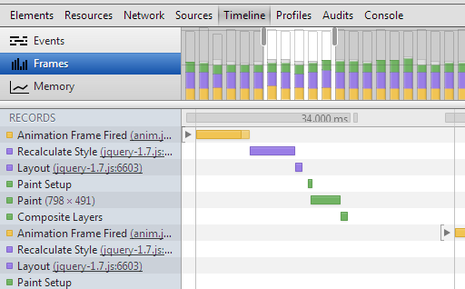
Timeline panel
Notes:
The “Frames” view is a great visualization for animation, scrolling, etc. perf
SEE LINKS

Slide 6
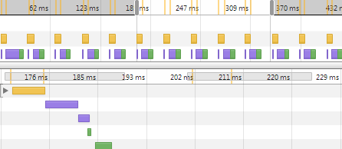
Custom Timeline Markers
console.timeStamp("Event foo");

Slide 7
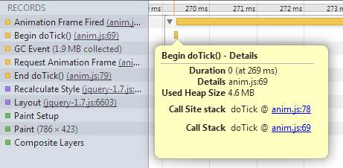
Custom Timeline Markers
console.time("doTick()");
console.timeEnd("doTick()");

Slide 8
Can Haz Automation?
Dev tools (including Timeline) are built on an API
… a JSON API that’s exposed over a socket connection
Remote Debugging API
Telemetry testing framework
Built atop the debugging API
Python scripts & testcase templates (PageMeasurements)
Includes UI automation abilities – click, scroll, etc. (Aided by a scrolling API it enables in Chrome)
Notes:
Timeline panel is manually-driven
Telemetry framework gives you same data, but can be automated – e.g. for continuous integration
SEE LINKS

Slide 9
Can Haz Automation?
myPage.json
{
"url": "http://localhost:8080/myPage",
"smoothness": [
{action: scroll, selector: ".main-content"}
]
}
Grab Chrome src (need not compile)
tools/perf/run_multipage_benchmarks
–browser=system smoothness_benchmark myPage.json
Notes:
Telemetry test runner takes JSON input, gives JSON output

Slide 10
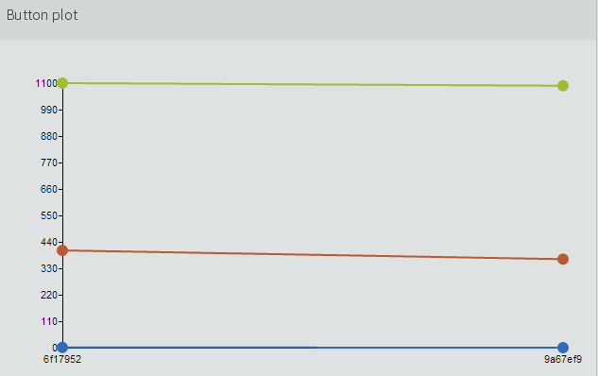
Can Haz Automation?
Awesome examples:
Run tests: https://github.com/topcoat/topcoat/tree/master/test/perf/telemetry
Track results, visualize with D3: https://github.com/topcoat/topcoat-server
Notes:
Topcoat project uses Telemetry for automated testing – great example of real-world usage
Topcoat-server is a Node server for tracking these results over time & visualizing the data via D3

Slide 11

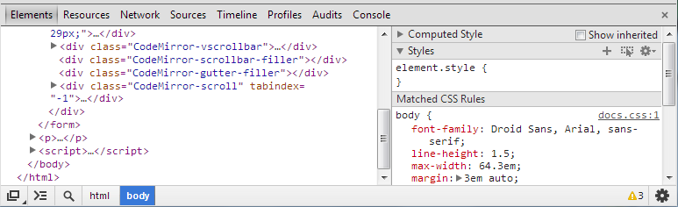

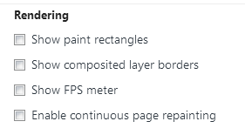
FPS Meter & Continuous Repainting
Notes:
Invaluable assessing rendering performance!
SEE LINKS

Slide 12
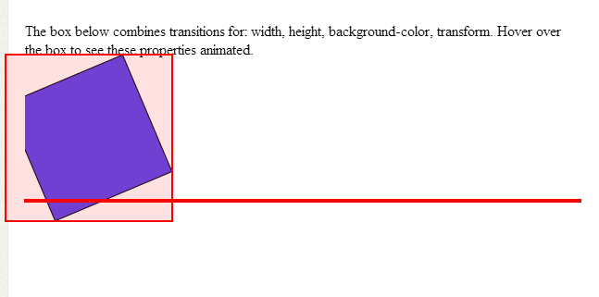
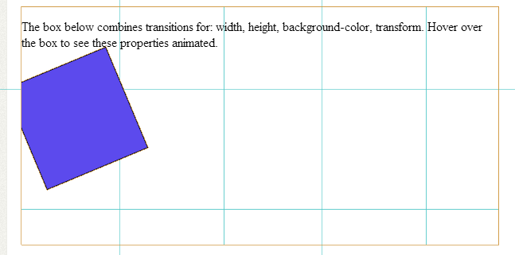
Paint Rectangles & Layer Borders
Notes:
Paint rectangles: great insight into painting (CPU-driven)
Composites layer borders: great insight into compositing (GPU-driven) & GPU texture memory usage
So, what if you need more…?

Slide 13

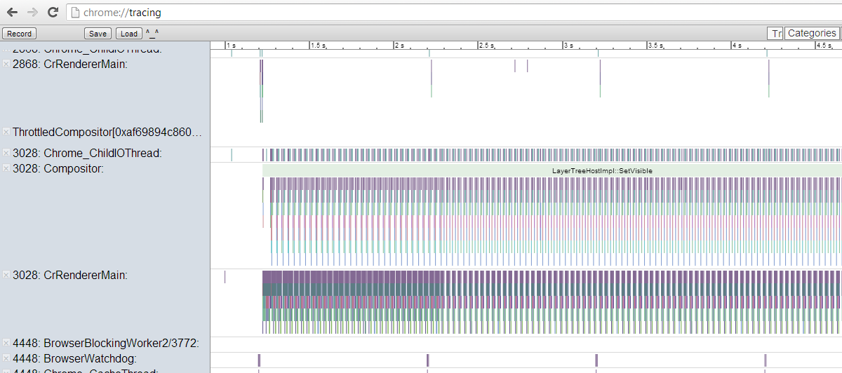
chrome://tracing
Notes:
Like Timeline view, but finer-grained: broken down by thread, more detail on native call stack
To zoom: alt+mousewheel, or W/S… To pan: A/D (like a video game)
Captures all threads across all tabs – close other tabs to reduce noise
Use browser’s Task Manager, or about://memory, to identify your tab’s PID
Use “x” buttons to hide other threads
Look for U-shaped individual frames: compositor kicks off frame, renderer does most of the work, compositor wraps it up
Vertical axis is ~native call stack, horizontal axis is time
Colors just uniquely identify method names – no other meaning
GPU & Present threads are what actually update the screen, synced with vsync
Not always in phase with your tab’s compositor/renderer – makes measuring latency tricky
Compliments dev tools Timeline
Timeline: shows bounds of repaint rect, JS call stack that caused layout invalidation, etc.
Tracing: see whether bottlenack is GPU vs. compositor vs. renderer thread; see finer-grained info on browser native state
This view will have even more detail soon (after some rendering architecture changes in Chrome):
Mark frames more clearly
Visualize GPU textures & regions of them in use each frame
Visualize individual paint steps
SEE LINKS

Slide 14
2012 & Earlier
Notes:
Back before chrome://tracing, FPS meter, requestAnimationFrame(), etc. measuring render performance in JS was comically bad.
Like off by 2-3x – useless data.
(Because it doesn’t capture all the time spent in native rendering)
So back then, where did we get the “ground truth” data? Answer: a crazy hack…

Slide 15
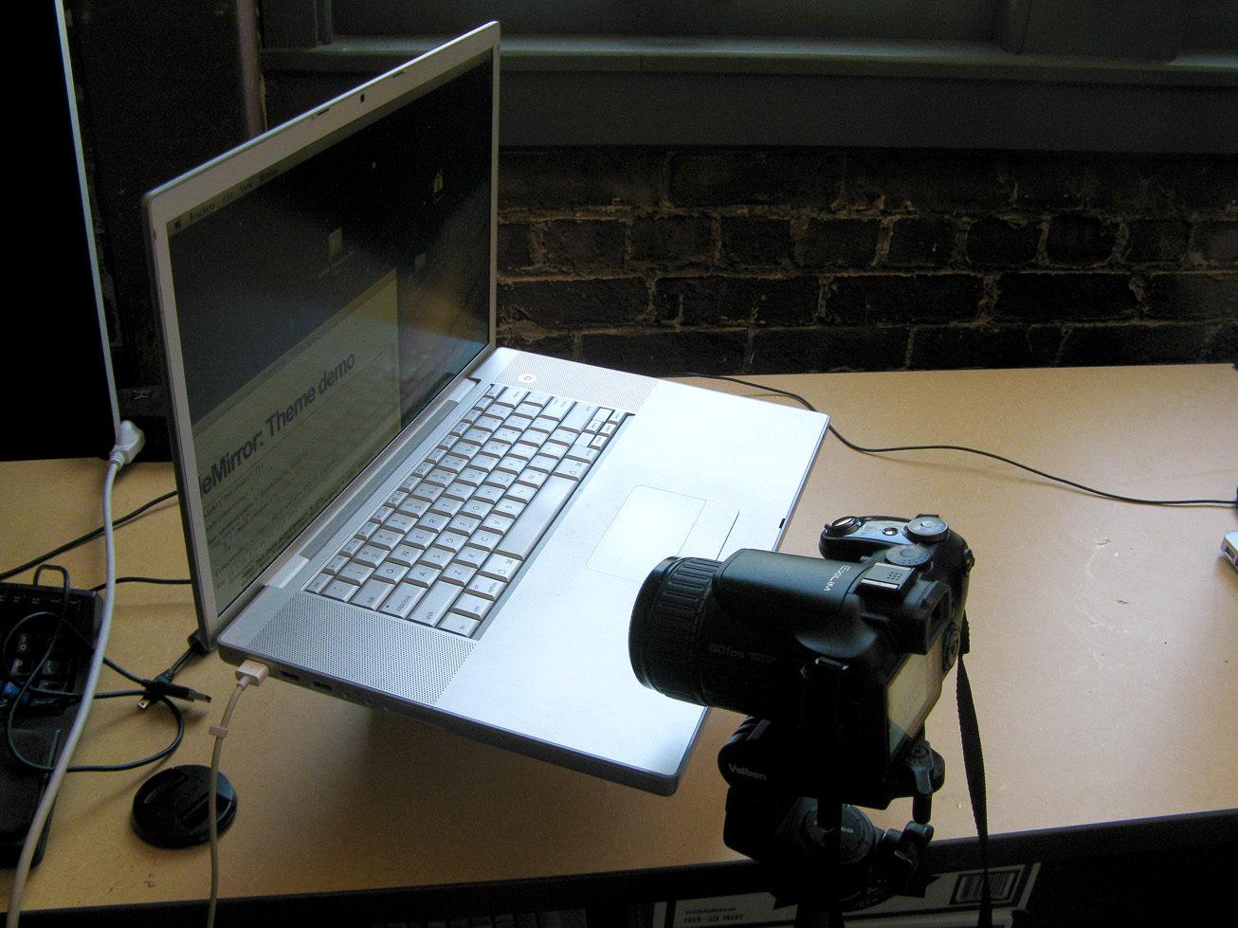
Ground Truth
Casio Exilim Pro EX-F1

Slide 16
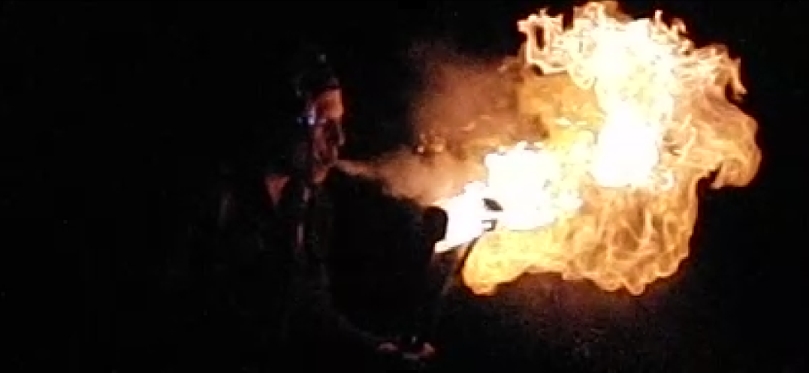
Ground Truth
Notes:
This is a fun toy for engineers to have…

Slide 17
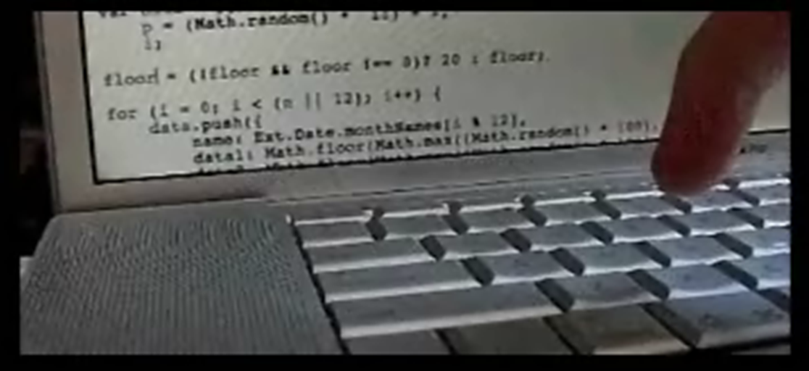
Ground Truth
Notes:
But you can use it to record usefull stuff like this. Hyper accurate, just time consuming.
Use as a last resort: prefer Timeline, FPS meter, requestAnimationFrame()-based timing.
But still has some advantages:
Tricky cases like latency (as in this video)
Allows comparison to native apps where you can’t instrument the src (for example: compare your mobile site or PhoneGap/Cordova-based app vs. a native app competitor)

Slide 18
Rendering
VM Guts
Dev tools Timeline
tricks
Memory profiling
tricks
Craziness
chrome://tracing
CPU profiling
tricks
High-speed cameras
V8 logging

Slide 19
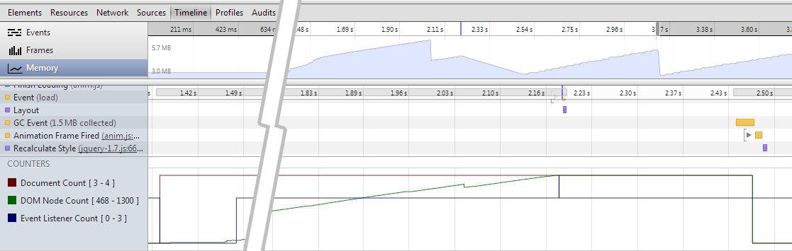
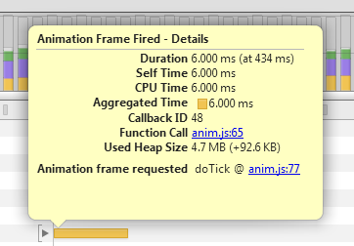
Memory Profiling
Notes:
Memory profiling: start with Timeline’s memory view
High level info:
1. Memory usage over time (graph)
2. DOM object count at bottom
Fine-grained info:
3. GC events on timeline
4. Memory deltas on individual JS yellow bars (includes GCable objects, though)

Slide 20
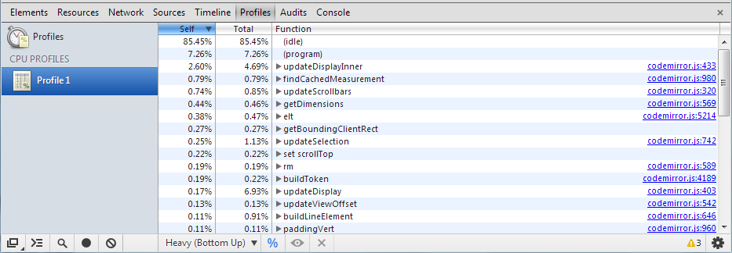
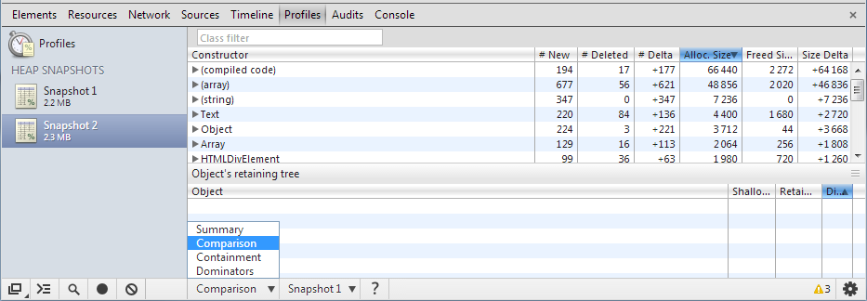
Memory Profiling
Notes:
Diffing heap snapshots:
Take snapshot
Do a memory neutral action, repeatedly (e.g. open/close something, switch view tabs back & forth)
Take 2nd snapshop
If it’s truly memory-neutral, diff should be empty!
Be sure to warmup the workflow first – both V8 and your code may be doing some lazy init.

Slide 21
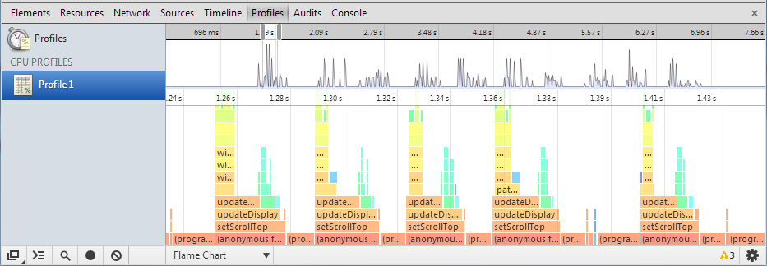
CPU Profiling ‘Flame Chart’
Notes:
(Canary only for now)
Visualizes CPU usage over time – not one big bucket over whole profiling session, like the normal view.
Graph on top: overview of whole session, Y axis = JS activity (CPU usage)
Zoom-in chart on bottom:
height = call stack (like chrome://tracing but upside down)
width = time spent (so the X axis here maps to the Y axis of the overview graph)
colors – just uniquely identify functions, like chrome://tracing – not a “heat map”

Slide 22
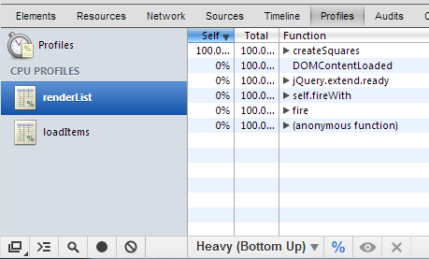
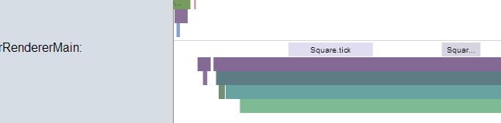
Instrumented CPU Profiling
Profiler
Nesting / semi-overlapping ok
chrome://tracing
console.profile("createList");
// ...
console.profileEnd("createList");
console.time("foo()");
// ...
console.timeEnd("foo()");
Notes:
To more narrowly target your timing info…
1. Profiler – automatically start/stop profiling sessions; can overlap arbitrarily
2. chrome://tracing – add your own timed ranges aligned with the native ones

Slide 23
V8 Logging Analysis
svn checkout http://v8.googlecode.com/svn/trunk/ v8
Mac: make dependencies Win: svn co http://gyp.googlecode.com/svn/trunk build/gyp
GCC: make native Xcode: build/gyp_v8 -Dtarget_arch=ia32 xcodebuild -project build/all.xcodeproj -configuration Release Visual Studio: svn co http://src.chromium.org/svn/trunk/deps/third_party/cygwin@66844 third_party\cygwin python build\gyp_v8 "C:\Program Files (x86)\Microsoft Visual Studio 10.0\Common7\IDE\devenv.com" /build Release build\All.sln
Set D8_PATH to build output folder
Install gnuplot & add to PATH
Notes:
V8’s profiler produces much more info than the dev tools show. Here’s how to get setup for capturing it.

Slide 24
V8 Logging: plot-timer-events
Close all Chrome instances
chrome --no-sandbox --js-flags="--prof --noprof-lazy --log-timer-events" "file://foo.html"
Find v8.log next to Chrome lib (version-numbered folder)
tools/plot-timer-events v8.log
Find timer-events.png next to v8.log
Note: plot-timer-events script may not work on Windows – see .plt hack in a sec.
Notes:
Close all Chrome processes – both Canary & stable (even if you’re testing in the other one – thanks to Google’s John McCutchan for pointing that out!)
Note: launch in a separate user profile if you have session/tab restore enabled!
plot-timer-events chugs for a while, then generates a PNG file
Data capture is entire lifetime of browser

Slide 25
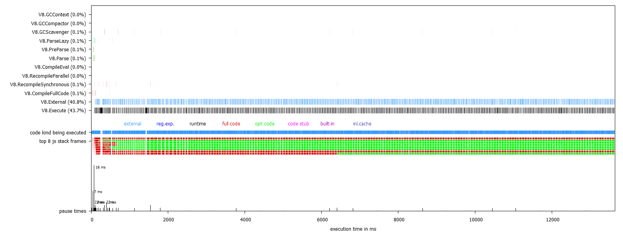
V8 Logging: plot-timer-events
Notes:
Like chrome://tracing, but instead of rendering state shows V8 state
GCScavenger: young space GC
GCCompactor: old space full GC
Execute: time spent executing JS code (as opposed to GC, waiting on native APIs to return, etc.)
Code kind: color indicates optimized (green) vs. unoptimized (red, “full code”)

Slide 26
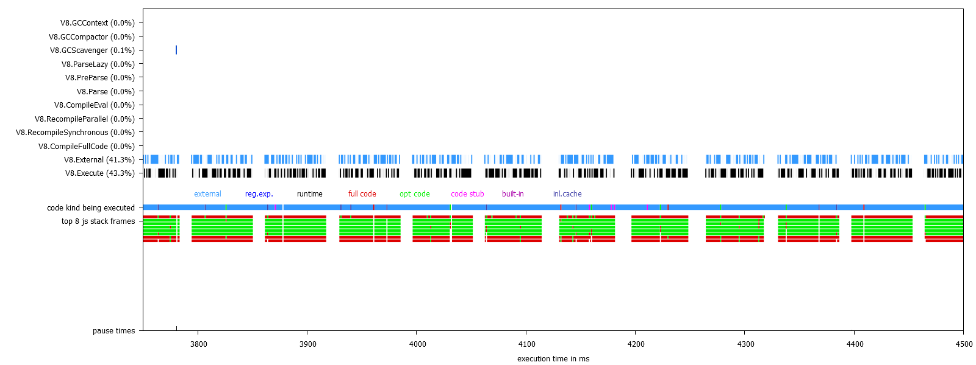
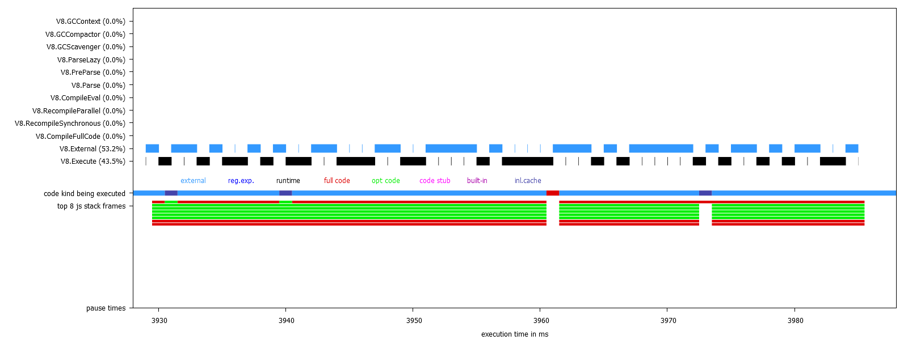
V8 Logging: plot-timer-events
tools/plot-timer-events v8.log --range=<start>,<end>
Notes:
Because the data capture is usually long, we need a way to zoom in on this view.
Use --range=<start>,<end> (in ms)

Slide 27
V8 Logging: plot-timer-events
echo -e "plot-range,$plot_range\ndistortion,$distortion"
| cat - v8.log | $D8_PATH/d8 tools/csvparser.js tools/splaytree.js tools/codemap.js tools/profile.js tools/profile_view.js tools/logreader.js tools/tickprocessor.js tools/plot-timer-events.js
| less 2>/dev/null > timer-events.plt
set terminal pngcairo size 1600,600 enhanced font 'Helvetica,10'
set yrange [0:23.5]
set xlabel "execution time in ms"
set xrange [1:13646.018000000004]
set style fill pattern 2 bo 1
set style rect fs solid 1 noborder
set style line 1 lt 1 lw 1 lc rgb "#000000"
…
set object 1 rect from 50.00350000000002, 11.17 to 50.005000000000024, 11.83 fc rgb "#000000"
set object 2 rect from 51.00200000000001, 11.17 to 51.00650000000003, 11.83 fc rgb "#000000"
set object 3 rect from 80.00750000000004, 11.17 to 81.01000000000005, 11.83 fc rgb "#000000"
set object 4 rect from 82, 11.17 to 83.01000000000005, 11.83 fc rgb "#000000"
set object 5 rect from 84, 11.17 to 84.01000000000005, 11.83 fc rgb "#000000"
set object 6 rect from 85.00150000000001, 11.17 to 85.01600000000008, 11.83 fc rgb "#000000"
…
Notes:
Can hack the plot-timer-events script to generate an intermediate .plt file
Just text – drawing commands. Delete first line to open in a gnuplot GUI viewer.
Zoom: ctrl+wheel to zoom / pan LR: shift+wheel / pan UD: wheel
Right-drag a rect to zoom in on it
Case of beer to the first person who writes a JS+D3 renderer for this! (or adds it to webkit dev tools)

Slide 28
V8 Logging: tick processor
tools/mac-tick-processor.bat v8.log > tick-report.txt
(or \win-…)
[Bottom up (heavy) profile]:
Note: percentage shows a share of a particular caller in the total
amount of its parent calls.
Callers occupying less than 2.0% are not shown.
ticks parent name
3155 23.2% C:\Users\pflynn\AppData\Local\Google\Chrome SxS\Application\29.0.1521.0\chrome.dll
2035 64.5% LazyCompile: jQuery.extend.style file:///.../jquery-1.7.js:6565
2033 99.9% LazyCompile: *<anonymous> file:///.../jquery-1.7.js:6520
1997 98.2% LazyCompile: *jQuery.extend.access file:///.../jquery-1.7.js:829
1997 100.0% LazyCompile: *jQuery.extend.access file:///.../jquery-1.7.js:829
1997 100.0% LazyCompile: *jQuery.fn.css file:///.../jquery-1.7.js:6514
Notes:
If the plot was showing a lot of red, you’ll want to know what unoptimized code that is
Asterisk = optimized / No asterisk = unoptimized
Now that you know which function is unoptimized, next question is why

Slide 29
V8 Logging: opt/deopt tracing
chrome --no-sandbox --js-flags="--trace-opt-verbose --trace-deopt" "file://foo.html" > opt-log.txt
[disabled optimization for 0x2474ca11
<JS Function foo.bar (SharedFunctionInfo 0x47820a4d)>,
reason: eval]
Note: may not work on Windows.
Notes:
This output can be tough to read and doesn’t always seem to “mention” every function
But if you find your function name in there, the “reason” is very valuable – tells you why it was ineligible for optimization, or why it was “deoptimized” (optimized originally, then kicked back to unoptimized after violating some assumption V8 had made).
A lot of this V8 info may show up in chrome://tracing soon – maybe even the full dev tools down the road

Slide 30
Or…
Ignore all this!
Notes:
3 good reasons to ignore this whole talk!

Slide 31
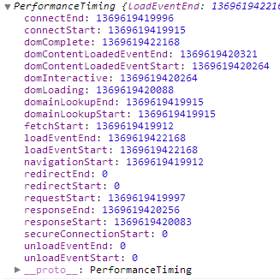
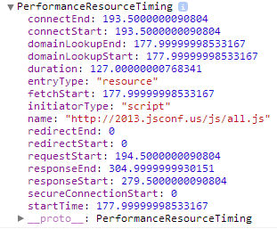
1. Is Network Performance More Important?
var loadTiming = performance.timing;
var resources = performance.webkitGetEntriesByType("resource");
Notes:
Loading time may bother users more than runtime perf
Hard to measure from server or from pure JS – need browser’s help to track timing info. Luckily these APIs offer exactly that.
Perceived perf is most important. Talk to server asynchronously, don’t block parts of your UI. Google Docs, Trello, etc. feel so responsive because network IO delays are almost entirely hidden from users.

Slide 32

Performance APIs
Resource Timing
Load timing of each resource on page
Async Scroll
API to test scrolling performance
Display Performance
API for frame rate, etc.
Web Performance Working Group
Notes:
W3C WPWG produced requestAnimationFrame() and the resource-load timing APIs.
They’re now starting work on more APIs oriented toward rendering perf.
Async Scroll is like a standardized version of the scroll-simulation API used by Chrome Telemetry (see earlier slides). Valuable – it’s hard to get user input consistent for perf testing, let alone get it automated.

Slide 33
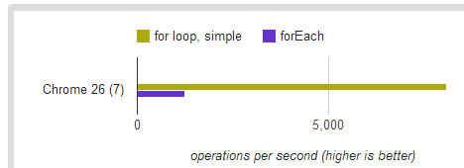
2. Good Enough Already?
function createMenuItems() {
array.forEach(function (item) {
whatever(item);
});
}
OMGZ!
1258 ops/sec x 10,000 iterations
= 12,580,000 iterations/sec
vs. 80,810,000 iterations/sec
Notes:
Resist tendency to jump the gun.
It’s NOT a best practice to make code harder to read/maintain, purely for speculative perf gains.
Best practice is to identify real, quantifiable bottlenecks your users care about, & fix them specifically.

Slide 34
3. Better Uses of Time?
Engineering time is a finite resource
More features
Fix bugs
Improve documentation
More testing
Ship sooner
Support more platforms
Improve usability
Architectural/code cleanup
Notes:
Should spend time on most important. Here are some things that might be more important than improving performance.
Thanks!

